Slide 1
3.5 Operations on Functions
What is a Operation?
What is a Function?

Slide 2
Creating new Functions: Sums and Differences of Fns
Example 1: Sum and difference Functions

Slide 3
Creating New Functions By Products and Quotients
Example 2: Product and Quotient Functions
Caution: Find domain of f and g

Slide 4
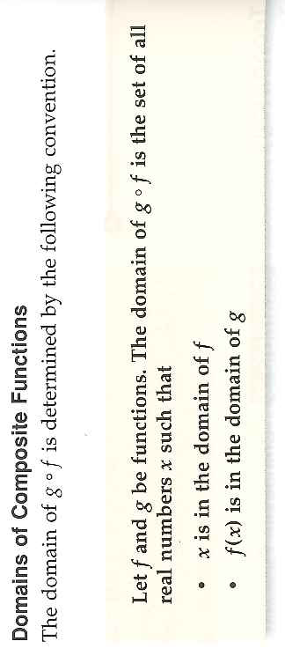
Composition of Functions

Slide 5
Example 3: Writing Composite Functions and Find Domain

Slide 6
Example 4: The Area of a Circular Puddle
How can we determine when our little puddle will be all gone☹?

Slide 7
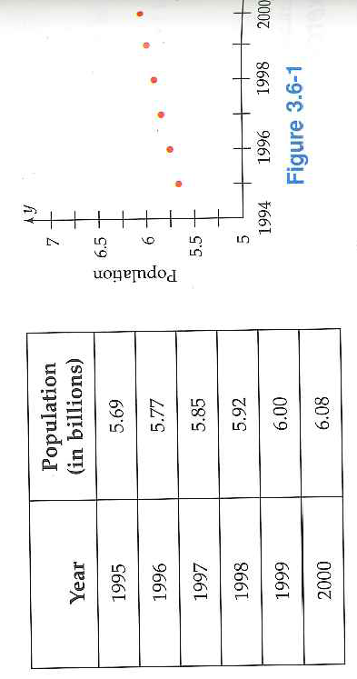
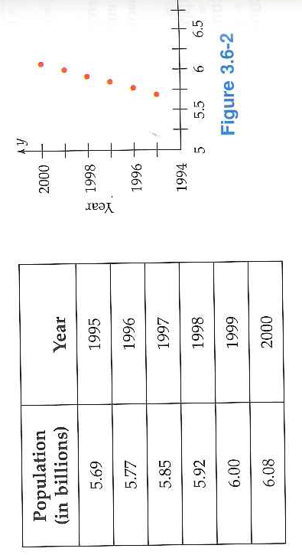
3.6 Inverse Functions
Starter:

Slide 8
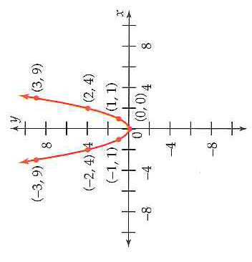
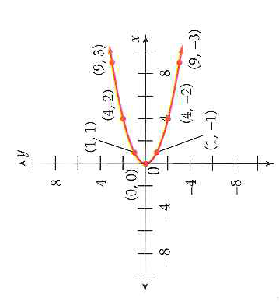
3.6 Inverse Functions
When you exchange the input and output values of a function you get a new relation called an inverse relation.
What is a relation again??
And what is a function again??
Sometimes the inverse of a function is also a function

Slide 9
Example 2: Finding the Inverse from an Equation
We now know how to find the graph of the inverse... But what about the equation
The quadratic formula is your friend!

Slide 10
When is the inverse of a function also a function?
Say What?
Mapping Diagrams:
Remember the Vertical Line test?

Slide 11
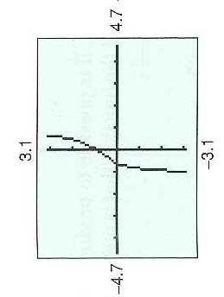
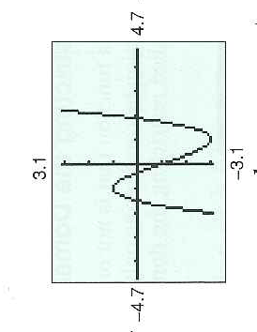
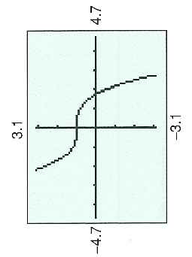
The Horizontal Line Test: Making life easy.

Slide 12
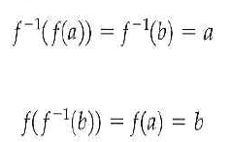
*Using Composition to Determine Inverse Functions
This is what the inverse does:
Example 7: Verifying The Inverse of a Function
Add 45,47,49 to your homework!

Slide 13
3.5Hmwr:1,5,9,13,15,19,21,23,31,39,57 3.6Hmwr:1, 9-19odd, 31 Remember to Study for Test next Class 3.1, 3.2, 3.3, 3.4, 3.5, 3.6 Review Qus:

