Slide 1
3.4 Review of Linear Programming
Steps:
Write the inequalities (the constraints: keywords -less than, at most, etc)
Write the objective function (the equation for what I want to maximize or minimize)
Graph the inequalities and highlight the overlapping regions
Test the objective equation at the vertices of feasible region and determine which point maximizes or minimizes the objective

Slide 2
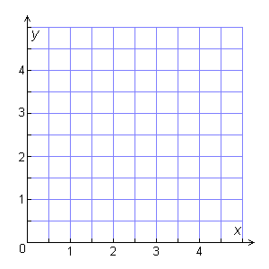
Check It Out! Example 1
Graph the feasible region for the following constraints.
x ≥ 0
The number cannot be negative.
y ≥ 1.5
The number is greater or equal to 1.5.
2.5x + 5y ≤ 20
The combined area is less than or equal to 20.
3x + 2y ≤ 12
The combined area is less than or equal to 12.

Slide 3
Check It Out! Example 2
Maximize the objective function P = 25x + 30y under the following constraints.
x ≥ 0
y ≥ 1.5
2.5x + 5y ≤ 20
3x + 2y ≤ 12

Slide 4
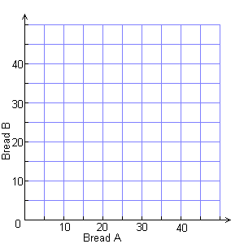
Example 1: Graphing a Feasible Region
Yum’s Bakery bakes two breads, A and B. One batch of A uses 5 pounds of oats and 3 pounds of flour. One batch of B uses 2 pounds of oats and 3 pounds of flour. The company has 180 pounds of oats and 135 pounds of flour available. Write the constraints for the problem and graph the feasible region.
Let x = the number of bread A, and
y = the number of bread B.

Slide 5
Example 2: Solving Linear Programming Problems
Yum’s Bakery wants to maximize its profits from bread sales. One batch of A yields a profit of $40. One batch of B yields a profit of $30. Use the profit information and the data from Example 1 to find how many batches of each bread the bakery should bake.

Slide 6
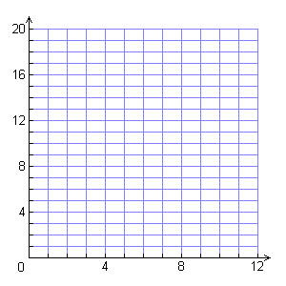
Check It Out! Example 3
A book store manager is purchasing new bookcases. The store needs 320 feet of shelf space. Bookcase A provides 32 ft of shelf space and costs $200. Bookcase B provides 16 ft of shelf space and costs $125. Because of space restrictions, the store has room for at most 8 of bookcase A and 12 of bookcase B. How many of each type of bookcase should the manager purchase to minimize the cost?

Slide 7
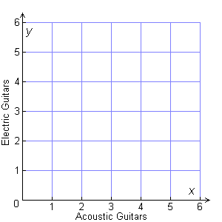
Lesson Quiz
1. Ace Guitars produces acoustic and electric guitars. Each acoustic guitar yields a profit of $30, and requires 2 work hours in factory A and 4 work hours in factory B. Each electric guitar yields a profit of $50 and requires 4 work hours in factory A and 3 work hours in factory B. Each factory operates for at most 10 hours each day. Graph the feasible region. Then, find the number of each type of guitar that should be produced each day to maximize the company’s profits.

