Slide 1
3.4 Linear Programming
Objective
Solve linear programming problems.
Vocabulary
linear programming
constraint
feasible region
objective function

Slide 2
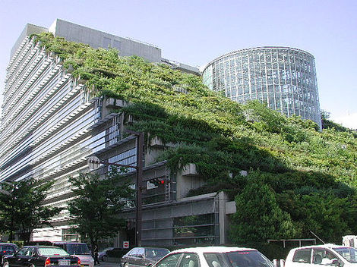
What type of plants:
Need to ask what are my objectives and constraints
Need to think about price, the amount of water required, and the amount of CO₂ absorbed

Slide 3
Linear Programming Definition
Linear programming is a method of finding a maximum or minimum value of an objective function that satisfies a given set of conditions called constraints
“My objective (what I want) is to absorb as much CO₂ as possible BUT I have certain constraints”

Slide 4
Let’s Learn Linear Programming!! Example 1:
Gillian is planning a green roof that will cover up to 600 square feet using either blue lagoon sedum and raspberry red sedum.
Each blue sedum will cover 1.2 square feet. Each raspberry red sedum will cover 2 square feet. Each plant cost $2.50, and Gillian must spend less than $1000. Gillian wants to maximize CO₂ absorption.

Slide 5
Ask yourself:
What do we want?
A: To maximize CO₂
Formula for total CO₂?
A: C=1.4b+2.1r → Objective Function
What do we need to know?
A:How much of each plants to use
What are our constraints?
Let’s look back at the question

Slide 6
Inequalities of the Constraints
*Notice that all the constraints involve the same variables
*We can use the graph of these constraints to find the number of each types of plants

Slide 7
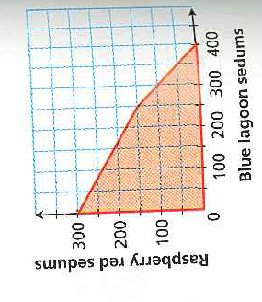
Graphing of the Constraints: The Feasible Region
*Feasible Region?
b- and r- values that satisfy the inequalities
BUT…….
Which combination of b and r (which point) would maximize CO₂ absorption (objective)?
The Vertex Principle of Linear Programming
If an objective function has a maximum or minimum value, it must occur at one or more of the vertices of the feasible region.

Slide 8
Test the Vertices Points of the Feasible Region In the Objective Function
C=1.4b+2.1r

Slide 9
Steps to Maximizing or Minimizing an Objective Function: Linear Programming
Write inequalities for all the constraints
Graph the constraints inequalities to find the feasible region
Write an equation for the objective
Substitute the vertices points from the feasible region into the objective function
Determine which point maximized or minimized your objective

Slide 10
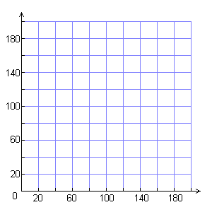
Example 3: Problem-Solving Application
Sue manages a soccer club and must decide how many members to send to soccer camp. It costs $75 for each advanced player and $50 for each intermediate player. Sue can spend no more than $13,250. Sue must send at least 60 more advanced than intermediate players and a minimum of 80 advanced players. Find the number of each type of player Sue can send to camp to maximize the number of players at camp.

