Slide 1
3.4 Graphs and Transformations

Slide 2
Transformations
When the rule of a function [f(x)=x] is algebraically changed in certain ways to produce a new function [g(x)=x+2], then the graph of the new function can be obtained from the graph of the original function by a simple geometric transformations.

Slide 3
Parent Functions
Functions can be grouped into families of functions
The parent function is a function with a certain shape that has the simplest rule for the shape
Ex. f(x)=x^2

Slide 4
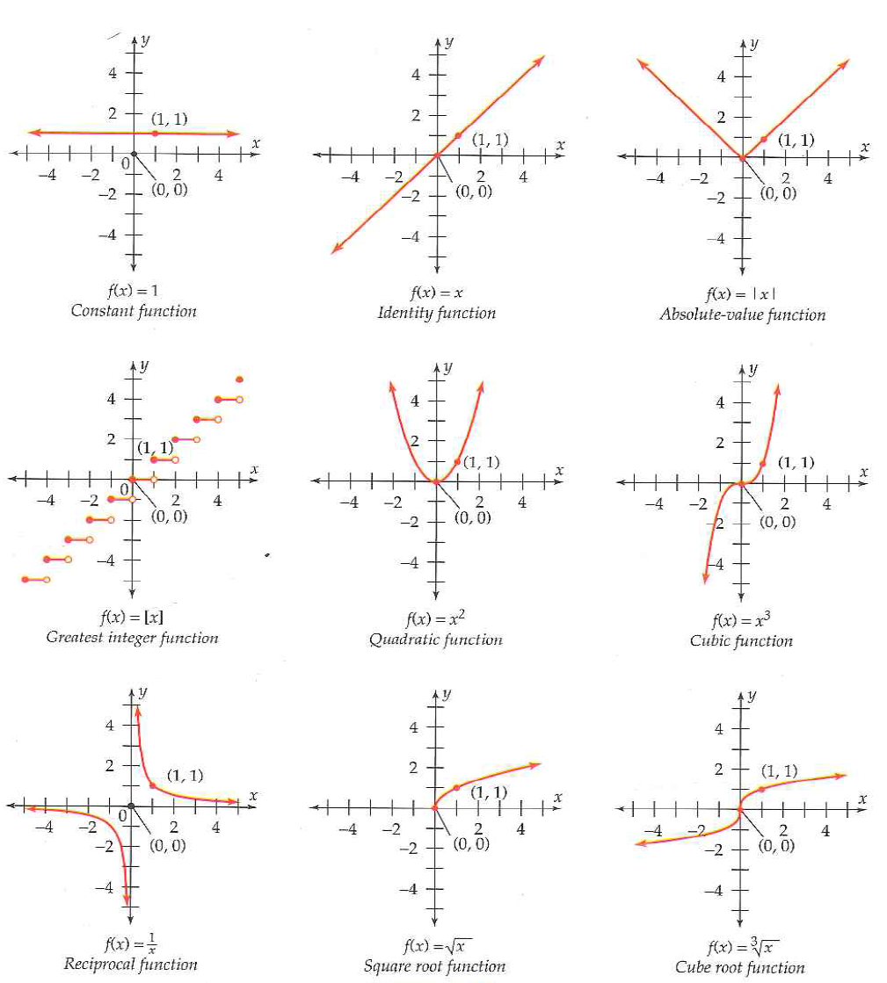
Basic Parent Functions

Slide 5
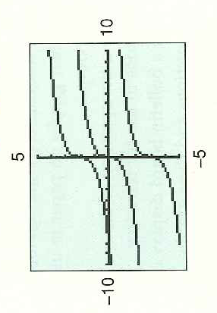
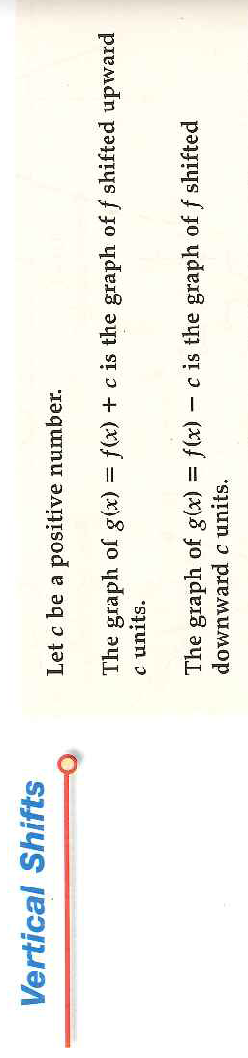
Transformations: Vertical Shifts

Slide 6
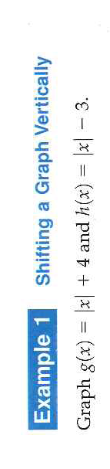
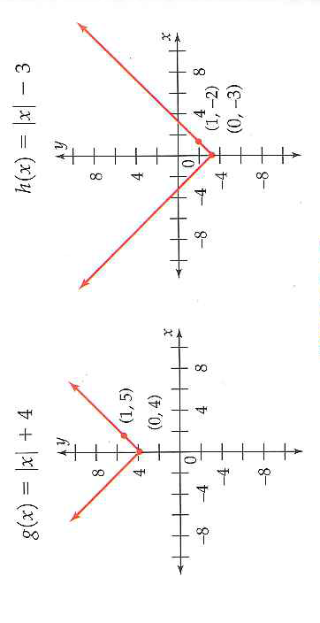

Slide 7
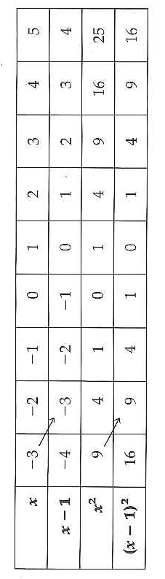
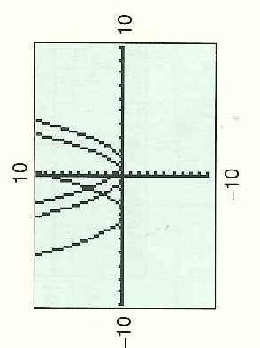
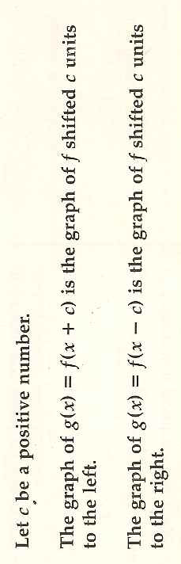
Transformations: Horizontal Shift

Slide 8
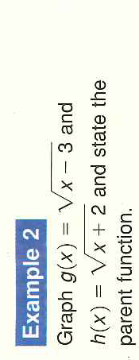
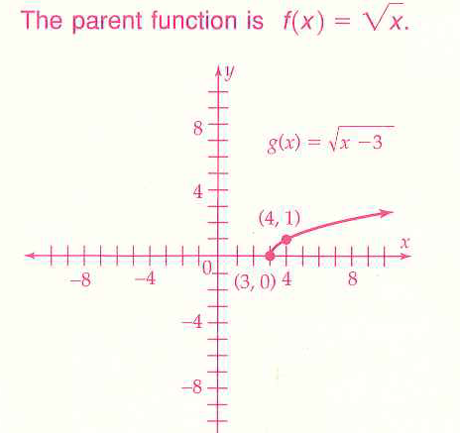
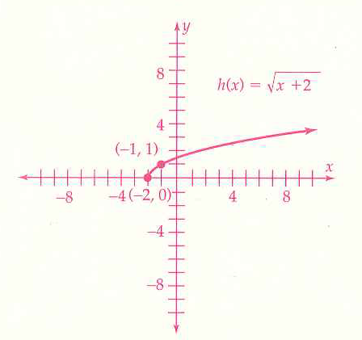

Slide 9

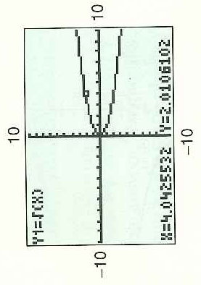

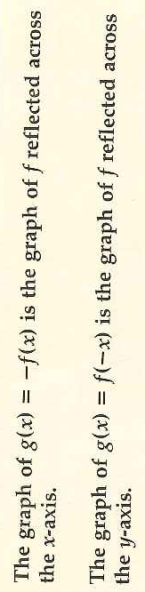
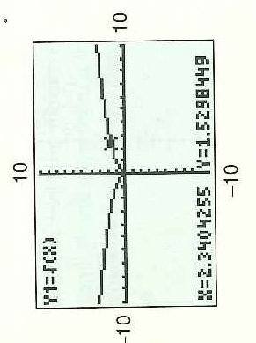
Reflections

Slide 10
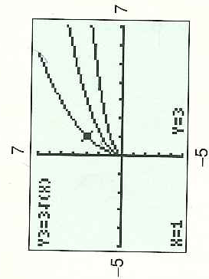
Vertical or Horizontal Stretches and Compressions
Function g was a horizontal compression and function h was a vertical stretch

Slide 11
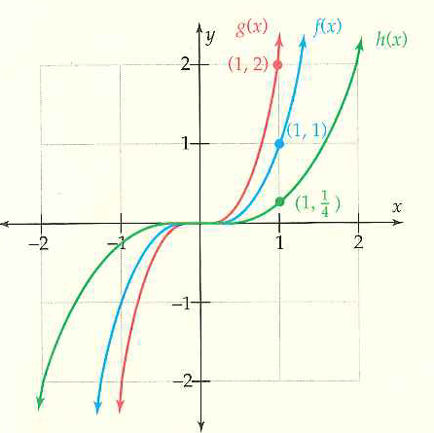
Vertical Stretch and Compression

Slide 12

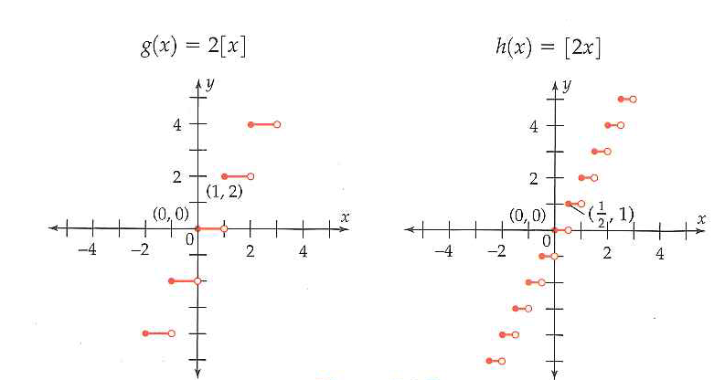
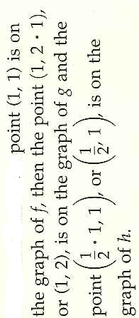
Vertical and Horizontal Stretch

Slide 13
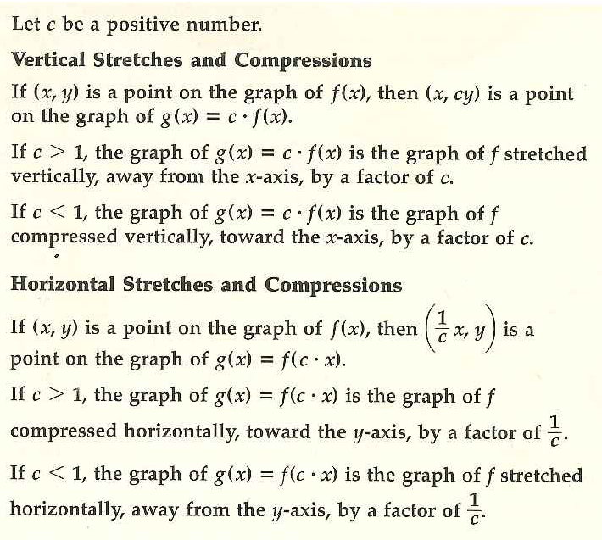

Slide 14
Review: Horizontal Shifts
g(x)=x^2+3
g(x)=x^2-5

Slide 15
Review: Horizontal Stretch/Compress
g(x)=(1/3x)^2
g(x)=(2x)^2
g(x)=(3/4x)^2

Slide 17
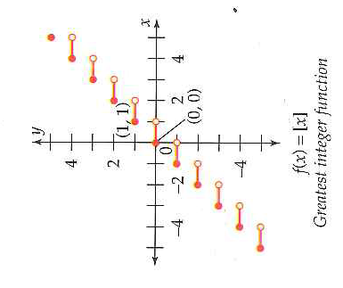
Need to practice picking the important points to move

Slide 18
Combining Transformations
Transformations can be combined to produce many different functions. There is often more than one correct order in which to perform these transformations; however, not every possible order is correct
Just follow this order and you will never mess up!

Slide 19
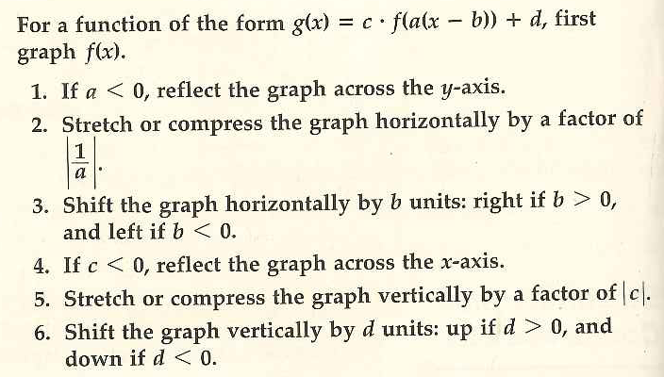
Combining Transformations
Reflect
Stretch/Compress
Shift
Reflect
Stretch/Compress
Shift

Slide 20
