Slide 1
3.4 Concavity and the Second Derivative Test
We will learn about:
Concavity -Points of Inflection - The Second Derivative Test
Review
If a functions wants to switch from decreasing to increasing. or visa versa, what are its options of approach/attack! (There is only three options)

Slide 2
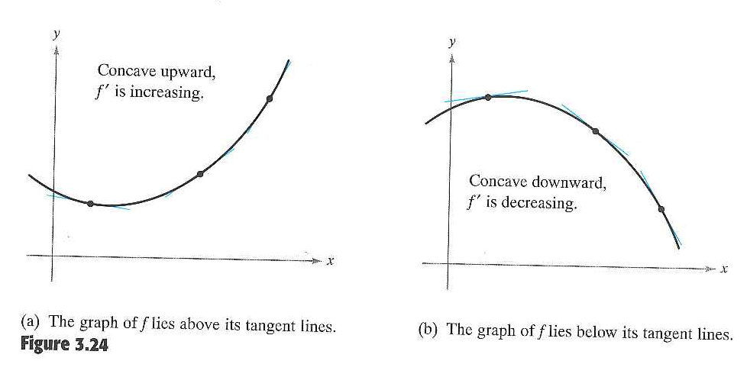
What are we doing
Last class: located intervals in which a function f increases or decreases.
Today: locate intervals in which the graph of f is curving upward or curving downward (Concavity)
*lines have no concavity!
How do we find these intervals of concavity?

Slide 3
Let’s Practice Some Drawing and Critical Thinking!

Slide 4
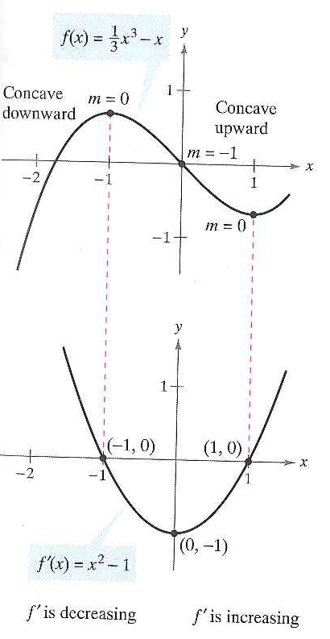

Slide 5
Test for Concavity
Q: When f´´(x) = 0 what does that tell us about f
Plan of attack: Just like before!

Slide 6
Example 1: Determining Concavity

Slide 7
Example 2: Your Turn

Slide 8
Points of Inflection:
When the graph switches concavity
Q: If this is where the functions switches concavity then it is also where what happens?
A1 derivative:
A2 2nd derivative:

Slide 9
Locating Inflection Points
Do what we did before but one step further
Locate the x-values at which f´´(x) = 0 or f´´ is undefined (don’t stop here)
Use these x-values to determine test intervals
Test the sign of f´´(x) in each test interval
See if between two intervals there was a concavity switch!

Slide 10
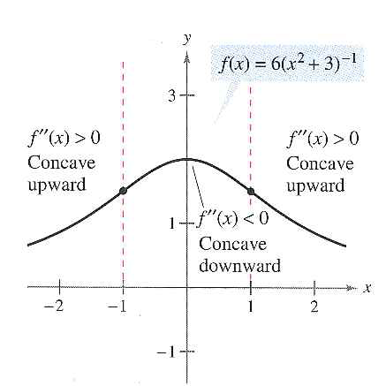
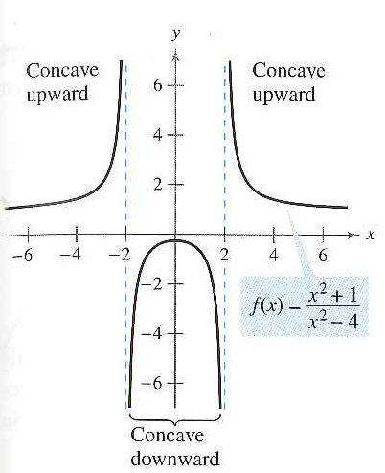
Look back at our results from example 1 & 2

Slide 11
Remember: Converse of Points of Inflection Theorem Not True!

Slide 12
Before How did we test to see if an extrema was a Minima or Maxima?

Slide 13
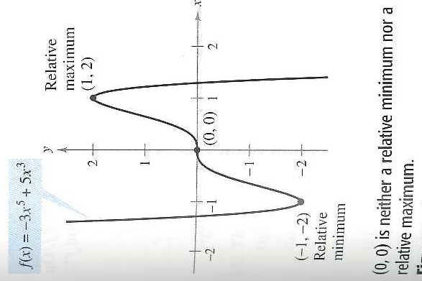
Last Example: Using 2nd Derivative test

Slide 14
3.4 Hmwr:

