Slide 1
3.4 Review of Linear Programming
Answers
Steps:
Write the inequalities (the constraints: keywords -less than, at most, etc)
Write the objective function (the equation for what I want to maximize or minimize)
Graph the inequalities and highlight the overlapping regions
Test the objective equation at the vertices of feasible region and determine which point maximizes or minimizes the objective

Slide 2
Check It Out! Example 1
Graph the feasible region for the following constraints.
x ≥ 0
The number cannot be negative.
y ≥ 1.5
The number is greater or equal to 1.5.
2.5x + 5y ≤ 20
The combined area is less than or equal to 20.
3x + 2y ≤ 12
The combined area is less than or equal to 12.

Slide 3
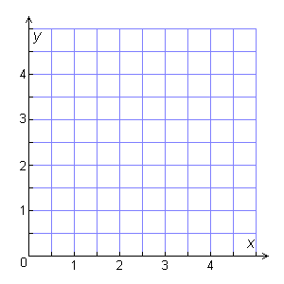
Check It Out! Example 1 Continued
Graph the feasible region. The feasible region is a quadrilateral with vertices at (0, 1.5), (0, 4), (2, 3), and (3, 1.5).
Check A point in the feasible region, such as (2, 2), satisfies all of the constraints. ✓

Slide 4
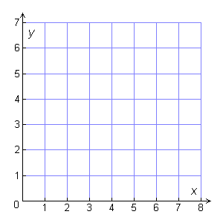
Check It Out! Example 2
Maximize the objective function P = 25x + 30y under the following constraints.
x ≥ 0
y ≥ 1.5
2.5x + 5y ≤ 20
3x + 2y ≤ 12
Step 1 Write the objective function: P= 25x + 30y
Step 2 Use the constraints to graph.
x ≥ 0
y ≥ 1.5
2.5x + 5y ≤ 20
3x + 2y ≤ 12

Slide 5
Check It Out! Example 2 Continued
Step 3 Evaluate the objective function at the vertices of the feasible region.
(x, y) | 25x + 30y | P($)
(0, 4) | 25(0) + 30(4) | 120
(0, 1.5) | 25(0) + 30(1.5) | 45
(2, 3) | 25(2) + 30(3) | 140
(3, 1.5) | 25(3) + 30(1.5) | 120
The maximum value occurs at the vertex (2, 3).
P = 140

Slide 6
Example 1: Graphing a Feasible Region
Yum’s Bakery bakes two breads, A and B. One batch of A uses 5 pounds of oats and 3 pounds of flour. One batch of B uses 2 pounds of oats and 3 pounds of flour. The company has 180 pounds of oats and 135 pounds of flour available. Write the constraints for the problem and graph the feasible region.
Let x = the number of bread A, and
y = the number of bread B.
Write the constraints:
x ≥ 0
The number of batches cannot be negative.
y ≥ 0
The combined amount of oats is less than or equal to 180 pounds.
5x + 2y ≤ 180
3x + 3y ≤ 135
The combined amount of flour is less than or equal to 135 pounds.

Slide 7
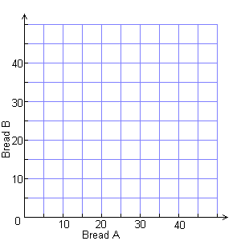
Graph the feasible region. The feasible region is a quadrilateral with vertices at (0, 0), (36, 0), (30, 15), and (0, 45).
Check A point in the feasible region, such as (10, 10), satisfies all of the constraints. ✓

Slide 8
Example 2: Solving Linear Programming Problems
Yum’s Bakery wants to maximize its profits from bread sales. One batch of A yields a profit of $40. One batch of B yields a profit of $30. Use the profit information and the data from Example 1 to find how many batches of each bread the bakery should bake.
Step 1 Let P = the profit from the bread.
Write the objective function: P = 40x + 30y
Step 2 Recall the constraints and the graph from Example 1.
x ≥ 0
y ≥ 0
5x + 2y ≤ 180
3x + 3y ≤ 135

Slide 9
Example 2 Continued
Step 3 Evaluate the objective function at the vertices of the feasible region.
(x, y) | 40x + 30y | P($)
(0, 0) | 40(0) + 30(0) | 0
(0, 45) | 40(0) + 30(45) | 1350
(30, 15) | 40(30) + 30(15) | 1650
(36, 0) | 40(36) + 30(0) | 1440
The maximum value occurs at the vertex (30, 15).
Yum’s Bakery should make 30 batches of bread A and 15 batches of bread B to maximize the amount of profit.

Slide 10
Check It Out! Example 3
A book store manager is purchasing new bookcases. The store needs 320 feet of shelf space. Bookcase A provides 32 ft of shelf space and costs $200. Bookcase B provides 16 ft of shelf space and costs $125. Because of space restrictions, the store has room for at most 8 of bookcase A and 12 of bookcase B. How many of each type of bookcase should the manager purchase to minimize the cost?

Slide 11
1
Understand the Problem
The answer will be in two parts—the number of bookcases that provide 32 ft of shelf space and the number of bookcases that provide 16 ft of shelf space.
List the important information:
Bookcase A cost $200. Bookcase B cost $125.
The store needs at least 320 feet of shelf space.
Manager has room for at most 8 of bookcase A and 12 of bookcase B.
Minimize the cost of the types of bookcases.

Slide 12
2
Make a Plan
Let x represent the number of Bookcase A and y represent the number of Bookcase B. Write the constraints and objective function based on the important information.
x ≥ 0
The number of Bookcase A cannot be negative.
y ≥ 0
The number of Bookcase B cannot be negative.
x ≤ 8
There are 8 or less of Bookcase A.
y ≤ 12
There are 12 or less of Bookcase B.
32x + 16y ≥ 320
The total shelf space is at least 320 feet.
Let P = The number of Bookcase A and Bookcase B. The objective function is P = 200x + 125y.

Slide 13
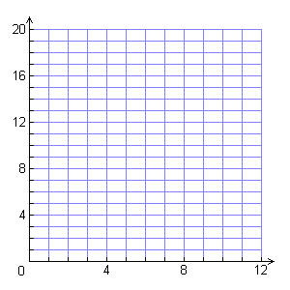
3
Solve
Graph the feasible region, and identify the vertices. Evaluate the objective function at each vertex.
P(4, 12) = (800) + (1500) = 2300
P(8, 12) = (1600) + (1500) = 3100
P(8, 4) = (1600) + (500) = 2100

Slide 14
4
Look Back
Check the values (8, 4) in the constraints.
x ≥ 0
y ≥ 0
x ≤ 8
y ≤ 12
8 ≥ 0
✓
4 ≥ 0
✓
8 ≤ 8
✓
4 ≤ 12
✓
32x + 16y ≥ 320
32(8) + 16(4) ≥ 320
256 + 64 ≥ 320
320 ≥ 320
✓

Slide 15
Lesson Quiz
1. Ace Guitars produces acoustic and electric guitars. Each acoustic guitar yields a profit of $30, and requires 2 work hours in factory A and 4 work hours in factory B. Each electric guitar yields a profit of $50 and requires 4 work hours in factory A and 3 work hours in factory B. Each factory operates for at most 10 hours each day. Graph the feasible region. Then, find the number of each type of guitar that should be produced each day to maximize the company’s profits.

Slide 16
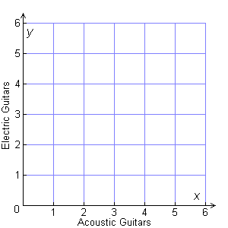
Lesson Quiz
1 acoustic; 2 electric

