Slide 1
3.3 Quadratic Functions
Objectives:
Define three forms for quadratic functions
Find the vertex and intercepts of a quadratic function and sketch its graph
Convert one form of a quadratic function to another

Slide 2
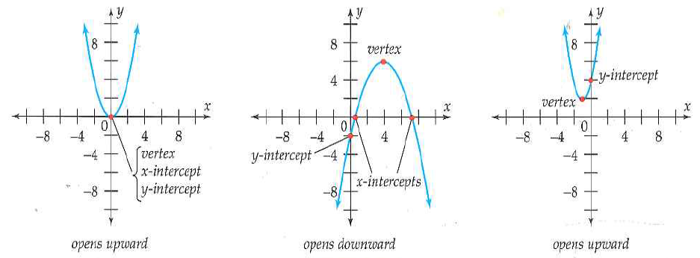
Quadratic Function: Graph Makes A Parabola Shape
The rule of a quadratic function is a polynomial of degree 2.
The rule? Polynomial of degree 2?
Example:
What can we say about parabola?

Slide 3
Three Forms of Writing a Quadratic Function
Transformation form:
Polynomial form:
x-Intercept form:
Transformation Form
* Most useful form for finding the vertex
Vertex: (h,k)
But how do we find the x and y intercepts?
(x,0)
(0,y)
←Be careful

Slide 4
Example 1:Transformation Form

Slide 5
Polynomial Form
* Most useful for finding the y-intercept
y-intercept:
x-intercept:
Vertex: (think of the transformation form)
Example 2: Polynomial Form

Slide 6
X-intercept Form → Has to be in this Form
* Most useful for finding the x-intercepts
x-intercept:
y-intercept:
Vertex:
Example 3: X-intercept Form

Slide 7
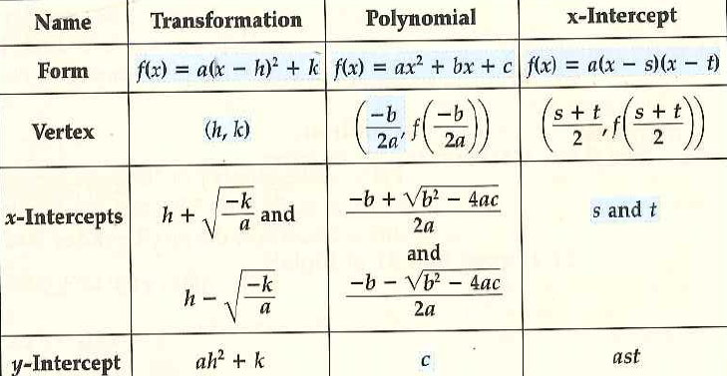
Summary and Changing from One Form to Another
Changing to a polynomial: Expand
Changing to a x-intercept: Expand and factor or use quadratic formula
Changing to a transformation: Expand and complete the square

Slide 8
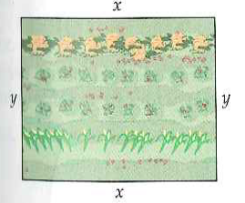
Example 6: Maximum Area for a Fixed Perimeter
Applications Involving Finding Vertex
3.3 Hmwr: p. 171: Qu:1,7,10,15-45oddccccc, 51

