Slide 1
3.3 Increasing and Decreasing Functions and the First Derivative Test

Slide 2
What are we doing?
In this section we are going to be using the derivative to classify whether a relative extrema is either a minima or maxima.
How did we do this classification before?

Slide 3
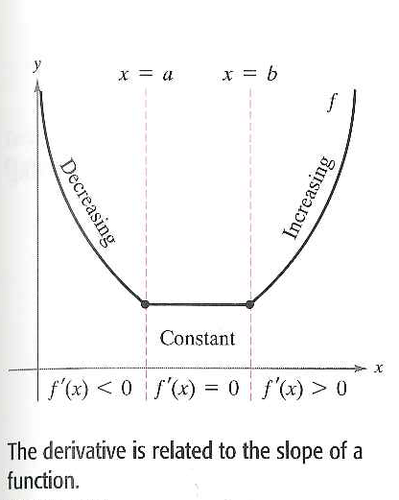
Increasing and Decreasing Functions
English Translation: a function is increasing if, as x moves to the right, its graph moves up, and is decreasing if its graph moves down

Slide 4
Let’s Look at the value of the Derivative
How does this make sense?
Cool proof on page 169

Slide 5
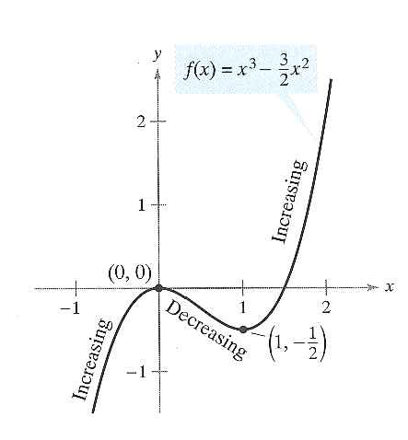
Example 1: Intervals on Which f is increasing or decreasing.
How do we know that it is either increasing or decreasing on the whole interval... Why not both?

Slide 6
The steps we followed

Slide 7
Strictly Monotonic?

Slide 8
The First Derivative Test

Slide 9
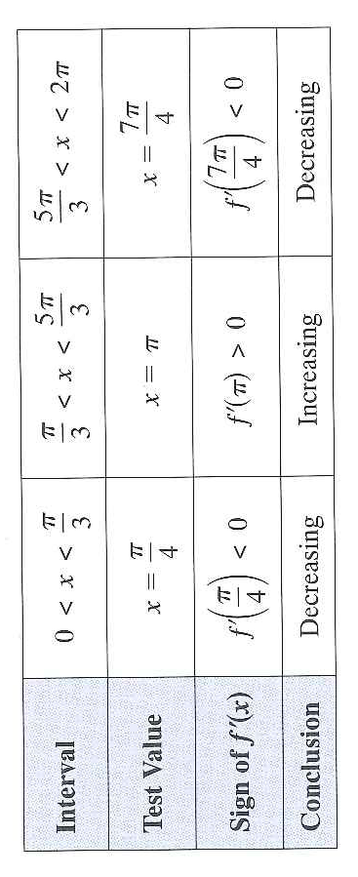
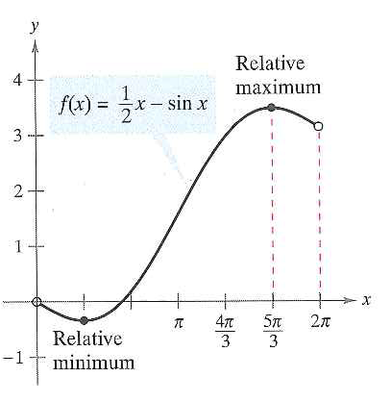
Example 2: Applying the First Derivative Test

Slide 10
Example 3: Your Turn
Let us practice our factoring

Slide 11
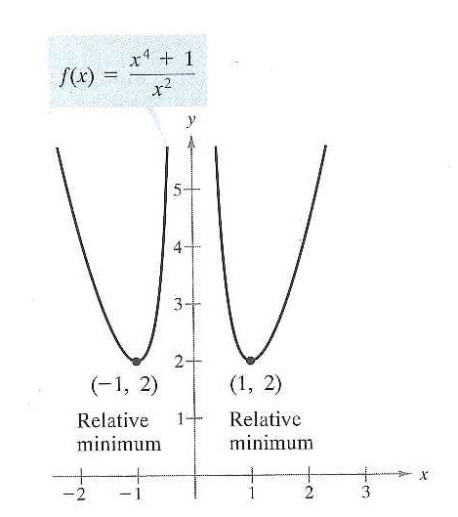
Example 4: Domain caution
X-values that are not in the domain of function must be used with the critical numbers to determine the test intervals
What would happen if we didn’t include in interval?

