Slide 1
3.2 Rolle’s Theorem and the Mean Value Theorem.
Objectives: Learn about Rolle’s Theorem and The Mean Value Theorem.

Slide 2
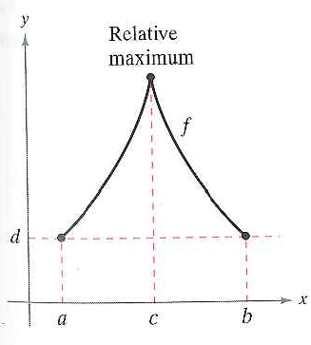
Rolle’s Theorem

Slide 3
Example 1: Illustrating Rolle’s Theorm

Slide 4
The Mean Value Theorem

Slide 5
Example 2: Finding a Tangent Line

Slide 6
Example 4: Finding an Instantaneous Rate of Change

Slide 7
3.2 Hmwr:1, 2, 5-11odd, 15, 21, 23, 24, 25, 29-33odd, 39-45 odd

