Slide 1
3.2 Graphs of Functions
Question?
Functions Defined by Graphs
What is the purpose of some graphs?
The purpose for some graphs is to define functions:
If the point (x,y) is on the graph of f, then y is the output produced by the input x (y = f(x)).

Slide 2
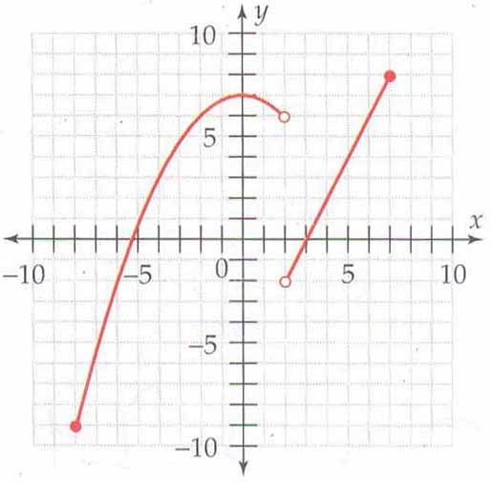
Example 1: A function defined by a graph
Determine the following
A. f(0) B. f(3)
C. The domain of f D. The range of f

Slide 3
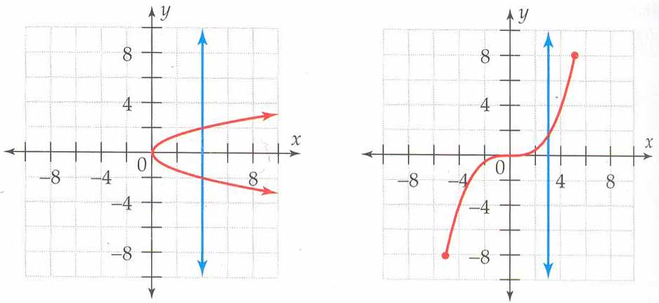
The Vertical Line Test: Sound Familiar?
Firstly, what is the equation of a vertical line?
Test: By drawing a vertical line though a graph we will be able to determine if the graph represents a function.
How so?
The Vertical Line Test
A Graph represents a function if and only if no vertical line intersects the graph more than once
Example 2:

Slide 4
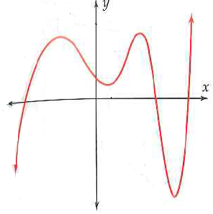
Analyzing Graphs: What are the most important parts of a graph?
x- and y-intercepts
Intervals of increase or decrease
local maxima and minima
Intervals of concavity (concave up or down)

Slide 5
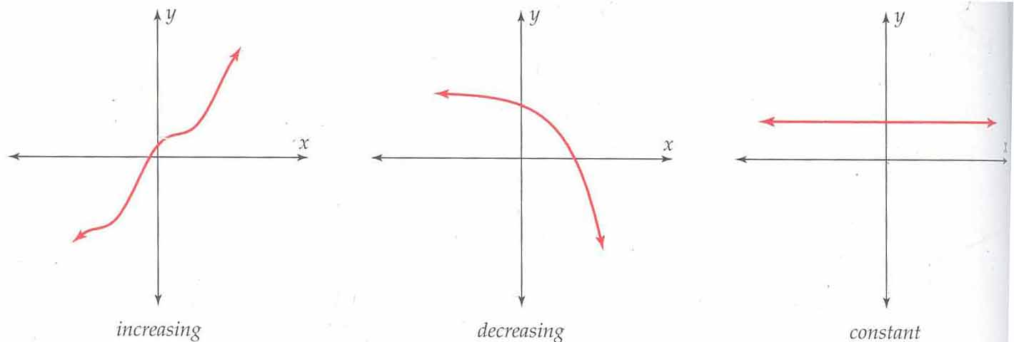
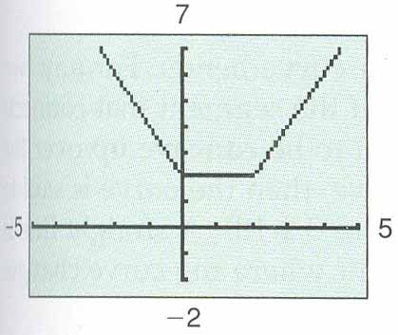
Increasing And Decreasing Functions
Graph is always rising, falling, or constant as you move from left to right along the x-axis.
Example 3:
On what intervals is the function increasing, decreasing, or constant?

Slide 6
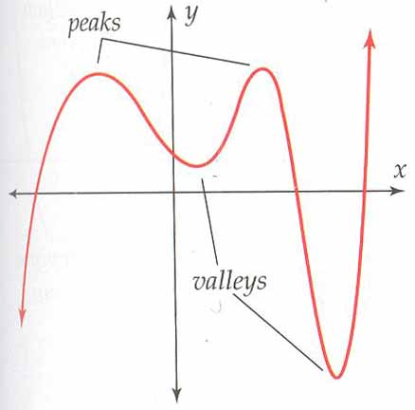
Local Maxima
A function f has a local maximum at x = c
if the graph has a peak at the point ( c, f(c) )
Conclusion?
f(x)≤f(c) for all x near c. (English translation please)
Local Minima
A function f has a local minimum at x = d if the graph has a valley at the point ( d, f(d) )
Conclusion?
f(x)≥f(d) for all x near d. (*Calculus connection)

Slide 7
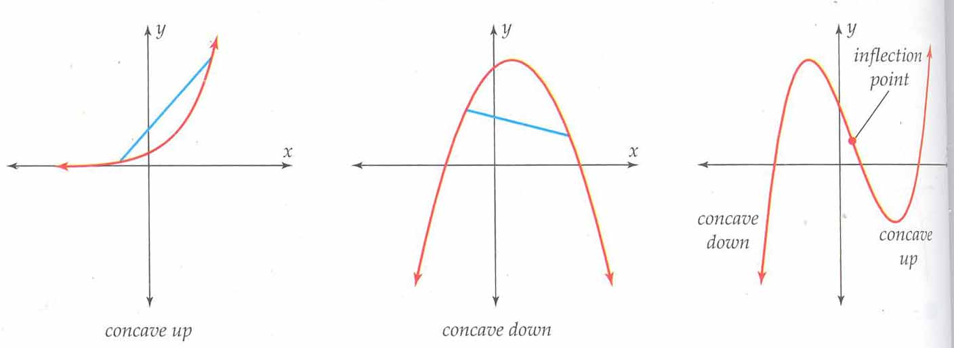
Concavity and Inflection Points
Concavity describes the way a curve bends.
Concave up or concave down? Test:
What is the purpose of the inflection point?
To determine the intervals between the different types of concavity

Slide 8
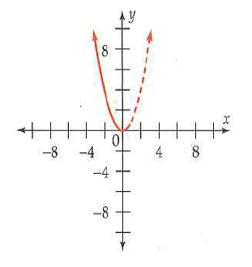
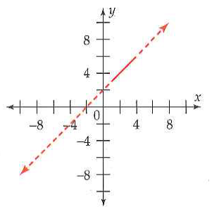
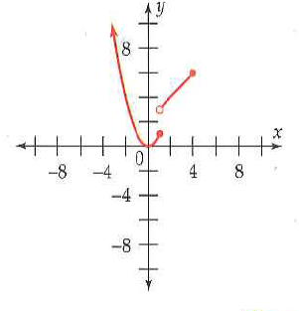
Example 4: Graphing a Piecewise-defined Functions

Slide 9
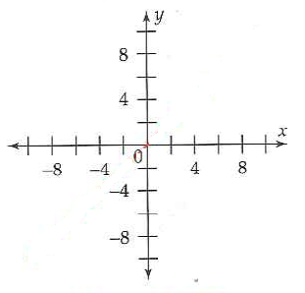
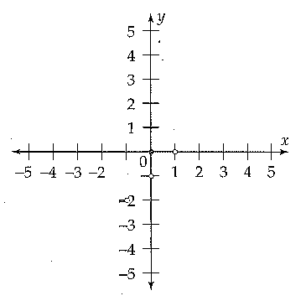
Ex5: The Absolute-Value Function
Ex6: The Greatest Integer Function

Slide 10
3.2 Hmwr: 1-17 all (already assigned) New Hmwr (Need a graphing cal for 1st 5 qus) 23, 29, 31, 33, 37, 41-53all, 60, 61

