Slide 1
2.5 Implicit Differentiation
We will learn about:
Implicit and Explicit Function (think ***be explicit)
Implicit Differentiation

Slide 2
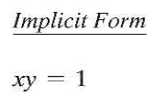
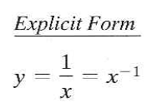
Implicit and Explicit Functions

Slide 3
Example 1: Differentiating With Respect to x

Slide 5
Ex3. Representing a Graph by a Differentiable Functions

Slide 6
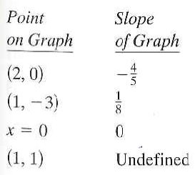
We can do Implicit Differentiation even on equation that do not represent Functions

Slide 7
Ex4. Finding the Second Derivative Implicitly

Slide 8
2.5 Hmwr 1-15odd, 17, 21, 23, 27 New:33, 35-39odd, 43, 45

