Slide 1
2.4 Writing Linear Functions
Last class we did...
Objectives
Use slope-intercept form and point-slope form to write linear functions.
Write linear functions to solve problems.
Vocabulary
Point-slope form

Slide 2
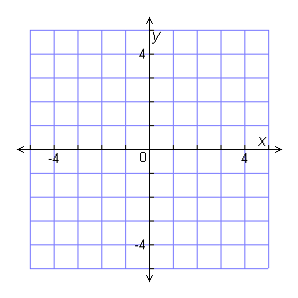
Example 1: Writing the Slope-Intercept Form of the Equation of a Line
Write the equation of the graphed line in slope-intercept form.
Step 1
Identify the y-intercept.
The y-intercept b is 1.
Step 2 Find the slope.
3
Choose any two convenient points to find slope.
4
3
4
–4
rise
run
–3
4
–3
Slope is = = – .
Step 3
Write the equation in slope-intercept form.
3
4
y = mx + b
m = – and b = 1.
3
4
y = – x + 1
The equation of the line is

Slide 3
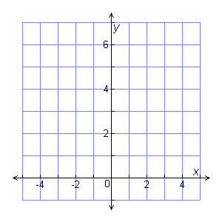
Check It Out! Example 1
Write the equation of the graphed line in slope-intercept form.

Slide 4
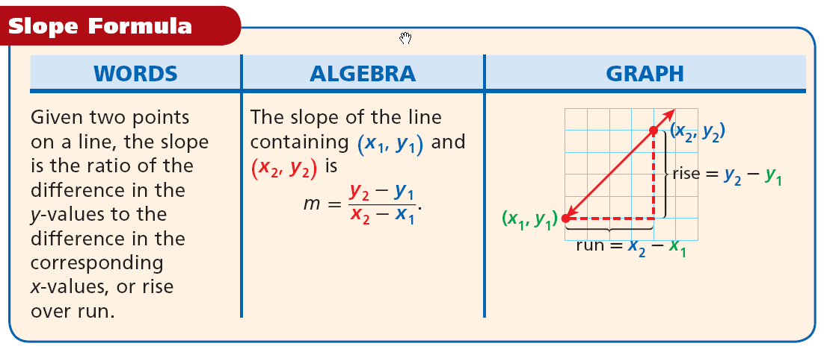
Example 2A: Finding the Slope of a Line Given Two or More Points
Find the slope of the line through (–1, 1) and (2, –5):
Let (x₁, y₁) =(–1, 1) & (x₂, y₂) = (2, –5).
Use the slope formula.
The slope of the line is –2.

Slide 5
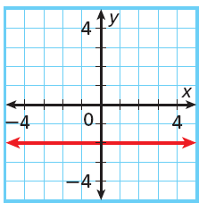
Example 2B: Finding the Slope of a Line Given Two or More Points
Find the slope of the line.
x | 4 | 8 | 12 | 16
y | 2 | 5 | 8 | 11
Choose any two points.
Example 2C: Finding the Slope of a Line Given Two or More Points
Find the slope of the line shown.
Choose any two points.

Slide 6
Example 3: Writing Equations of Lines
In slope-intercept form, write the equation of the line that contains the points in the table.
x | –8 | –4 | 4 | 8
y | –5 | –3.5 | –0.5 | 1
Remember always rewrite in slope-intercept form.

Slide 7
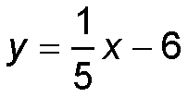
Example 4A: Linear Entertainment Application
The table shows the rents and selling prices of properties from a game.
Selling Price ($) | Rent ($)
75 | 9
90 | 12
160 | 26
250 | 44
Express the rent as a linear function of the price.
Let x = selling price and y = rent.
Find the slope by choosing two points. Let (x₁, y₁) be (75, 9) and (x₂, y₂) be (90, 12).
To find the equation for the rent function, use point-slope form.
y – y₁ = m(x – x₁)
Use the data in the first row of the table.
Simplify.

Slide 8
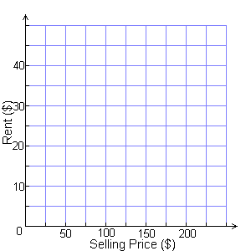
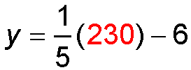
Example 4B: Entertainment Application
Graph the relationship between the selling price and the rent. How much is the rent for a property with a selling price of $230?
To find the rent for a property, use the graph or substitute its selling price of $230 into the function.
Substitute.
y = 46 – 6
y = 40
The rent for the property is $40.
Check It Out! Example 4a
Items | Cost ($)
4 | 14.00
7 | 21.50
18
Express the cost as a linear function of the # of items.

Slide 10
Example 5A: Writing Equations of Parallel and Perpendicular Lines
Write the equation of the line in slope-intercept form.
parallel to y = 1.8x + 3 and through (5, 2)
m = 1.8
Parallel lines have equal slopes.
y – 2 = 1.8(x – 5)
Use y – y₁ = m(x – x₁) with (x₁, y₁) = (5, 2).
y – 2 = 1.8x – 9
Distributive property.
y = 1.8x – 7
Simplify.
Example 5B: Writing Equations of Parallel and Perpendicular Lines
Write the equation of the line in slope-intercept form.
perpendicular to and through (9, –2)

