Slide 1
2.4 Other Types of Equations
And how to solve them!!

Slide 2
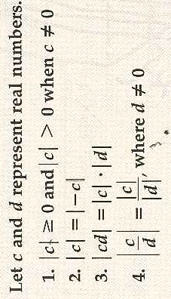
Definition of Absolute Value
Properties of Absolute Value

Slide 3
Example 1: Using the Definition of Absolute Value to Solve
Solve: abs(x + 4) = 5x - 2

Slide 4
Example 2: Solving Radical Equations
Note: sometimes you will have to square both sides of the equation twice in order to get rid of all the radicals!

Slide 5
Example 7: Solving a Fractional Equation

Slide 6
2.4 Hmwr:9-21odd, 29-37odd, 59-63odd

