Slide 1
2.3 Graphing Linear Functions
Objectives
Determine whether a function is linear.
Graph a linear function given two points, a table, an equation, or a point and a slope.
Vocabulary
linear function
slope
y-intercept
x-intercept
slope-intercept form

Slide 2
Meteorologists begin tracking a hurricane's distance from land when it is 350 miles off the coast of Florida and moving steadily inland.
The meteorologists are interested in the rate at which the hurricane is approaching land.
+1
+1
+1
+1
Time (h) | 0 | 1 | 2 | 3 | 4
Distance from Land (mi) | 350 | 325 | 300 | 275 | 250
Graph:
–25
–25
–25
–25
This rate can be expressed as .
Notice that the rate of change is constant. The hurricane moves 25 miles closer each hour.

Slide 3
Example 1A: Recognizing Linear Functions
Determine whether the data set could represent a linear function.
+2
+2
+2
What should this remind you of?
x | –2 | 0 | 2 | 4
f(x) | 2 | 1 | 0 | –1
–1
–1
–1
The rate of change, , is constant, . So the data set is linear.
Example 1B: Recognizing Linear Functions
x | 2 | 3 | 4 | 5
f(x) | 2 | 4 | 8 | 16
The rate of change, , is not constant. 2 ≠ 4 ≠ 8. Data set is not linear.

Slide 4
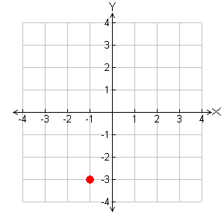
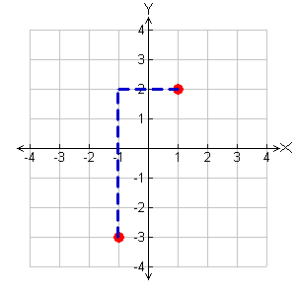
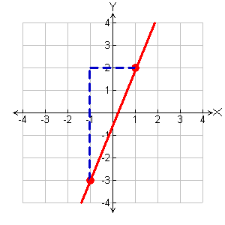
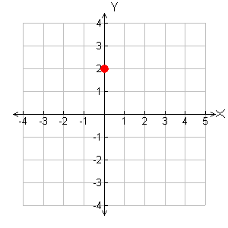
Rate of change: = : Slope
Example 2A: Graphing Lines Using Slope and a Point
Graph the line with slope that passes through (–1, –3).
Plot the point (–1, –3).
Slope: Move up 5 and right 2 to find another point.
Then draw a line through the points.
Ex 2B: Graphing Lines Using Slope and a Point
Graph the line with slope that passes through (0, 2).

Slide 5
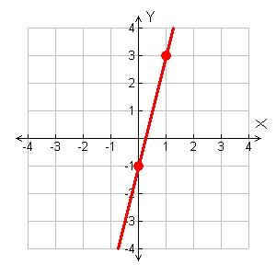
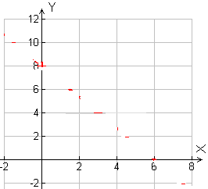
Linear functions in slope-intercept form:y = mx + b; m = slope and b = y-intercept.
Example 3A: Graphing Functions in Slope-Intercept Form
Write the function –4x + y = –1 in slope-intercept form. Then graph the function.
Solve for y first.
–4x + y = –1
+4x +4x
Add 4x to both sides.
y = 4x – 1
Ex 3B: Graphing Functions in Slope-Intercept Form
Write the function in slope-intercept form. Then graph the function.

Slide 6
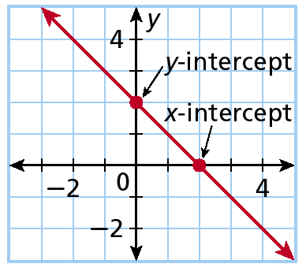
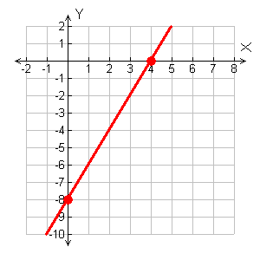
Example 4: Graphing Lines Using the Intercepts
Find the intercepts of 4x – 2y = 16, and graph the line.
x-intercept
Check It Out! Example 4
y-intercept
Find the intercepts of 6x – 2y = –24, and graph the line.

Slide 7
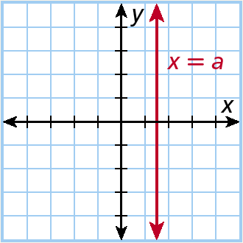
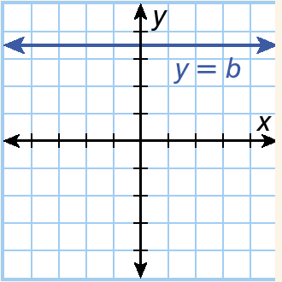
Vertical and Horizontal Lines
Vertical Lines | Horizontal Lines
The line x = a is a vertical line at a. | The line y = b is a vertical line at b.
The slope of a horizontal line is __________
The slope of a vertical line is_________

Slide 8
Example 5: Graphing Vertical and Horizontal Lines
Draw your own grid!!!
A. Graph the function defined by the equation, x = 2. (A line where the x-coordinate of each point is 2)
B. Graph the function defined by the equation, y = –4. (A line where the y-coordinate of each point is -4)

Slide 9
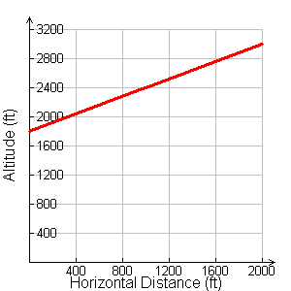
Example 6: Application
A ski lift carries skiers from an altitude of 1800 feet to an altitude of 3000 feet over a horizontal distance of 2000 feet. Find the average slope of this part of the mountain. Graph the elevation against the distance.

