Slide 1
2.3 Applications of Equations

Slide 2
Applied Problems Guideline

Slide 3
Example 1: Number Relations

Slide 4
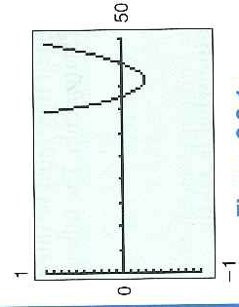
Example 1: Con’t

Slide 5
Read Example 2, 3, 6, 7 2.3 Hmwr: 1-4, 13, 15, 17, 19, 23, 25, 29

