Slide 1
2.1 The Derivative and The Tangent Line Problem
We are learning:
The Tangent Line Problem
The Derivative of a Function
Differentiability and Continuity

Slide 2
The Tangent Line Problem:
How would we define what a tangent line is?
Possible definitions:

Slide 3
Let us Explore to Help Us Think of a Definition
Let’s work together to see what the secant lines’ slopes are approaching!
Instead of doing the chart method of finding the limit we can use our analytical methods

Slide 4
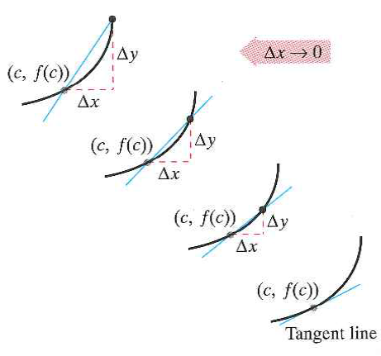
Analytical Method:

Slide 5
Ex: Tangent Lines to the Graph of a Nonlinear Function

Slide 6
The Derivative of a Function!!!
The limit used to define the slope of a tangent line is also:

Slide 7
Example 2: Finding the Derivative By The Limit Process

Slide 8
Example 3: Using the Derivative to Find the Slope at a Point

Slide 9
Stop for some Class work: 2.1 p. 99: 1,4,5,7,9,13,17,23,27-32,33,35

Slide 10
Differentiability and Continuity

Slide 11
Differentiability and Continuity
Continuity does not imply differentiability as shown by the next examples!

Slide 12
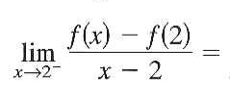
Example 6: A Graph with a Sharp Turn
Conclusion: At a sharp turn the derivative does not exist since it could be on two tangent lines!

Slide 13
Example 7: A Graph with a Vertical Tangent Line
Conclusion: If a portion of the graph gets to steep and has undefined slope then the derivative will also be undefined!
Cool proof in textbook!
Last 2.1 Hmwr: 45, 48, 50, 51-63odd, 69-71.

