Slide 1
2.1- Solving Equations Graphically

Slide 2
Mathematical Language
A solution of an equation is a number that make the equation true
3x+2=17
To solve an equation means to find all its solution
Two equations are equivalent if they have the same solutions
3x+2=17 and x-2=3
How could you change the first equation to get to the second?

Slide 3
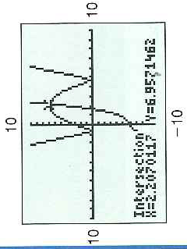
The Intersection Method
We are trying to find a x that makes the left side equal to the right side
Separate:
Find a input, a x-value, that makes the two outputs, the y values, the same.
This input will be the x-coordinate of the intersection point between the two graphs
Check:

Slide 4
The x-intercept Method

Slide 5
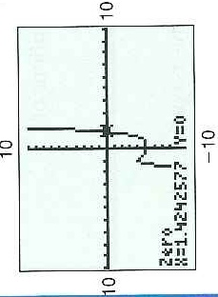
Example 2: Solving an Equation by Using the x-Intercept Method

Slide 6
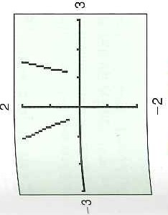
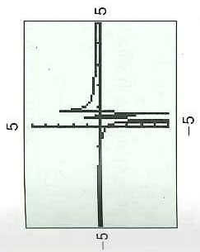
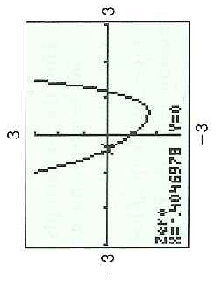
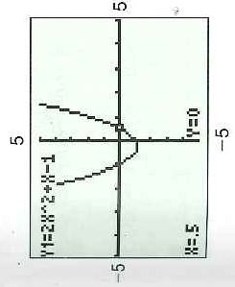
Making Things Easier: Technological Quirks

Slide 7
2.2 Solving Quadratic Equations Algebraically
Factoring
Taking the square root of both sides of the equation
Completing the square
Using the quadratic formula

Slide 8
Example 1: Solving a Quadratic Equation by Factoring

Slide 9
Taking the Square Root of Both Sides of an Equation
Why do we do plus or minus
Think of an equation that would have no solutions

Slide 10
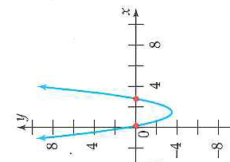
Solving a Quadratic Equation by Completing the Square
Notice no coefficient in front of x^2

Slide 11
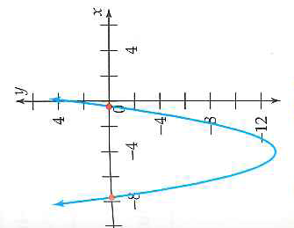
The Quadratic Formula: Our Friend

Slide 12
2.2 Hmwr: p. 1-11odd, 19-33odd, 47-55odd

