Slide 1
11.2 Areas of Triangles, Trapezoids, and Rhombi
Learning Targets:
We will learn to find the areas of triangles, trapezoids and rhombi
Why are we learning this?
In construction, area will be needed for structures with the above shapes.
What formulas of area do we already know?

Slide 2
Geometry Activity* Sketch Pad
Cut out two triangles of the exact same size
Cut one of your triangles along one of the altitudes
Create a rectangle and write down the formula for area of a rectangle
Then think what would the area of a triangle be:

Slide 3
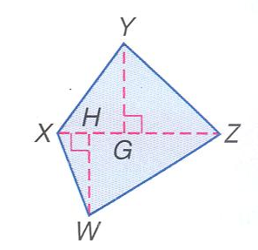
Example 1: Area of Triangles
You can choose any side to be the base as long as you have the corresponding altitude to represent the height*

Slide 4
Area of Trapezoids*
The area of a trapezoid is related to the area of a triangle.
Divide your trapezoid into triangles
When calculating the area of the triangles which height (altitude) should we use to be simple?

Slide 5
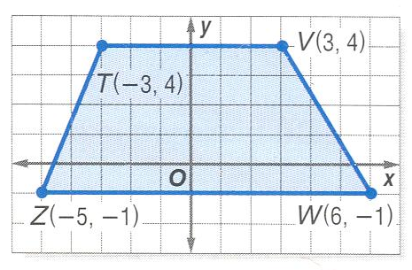
Ex 2: Area of a Trapezoid on the Coordinate Plane

Slide 6
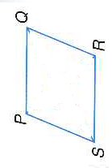
Area of a Rhombus
The area of a trapezoid is related to the area of a triangle.
Divide your trapezoid into triangles
When calculating the area of the triangles which height (altitude) should we use to be simple?

Slide 7
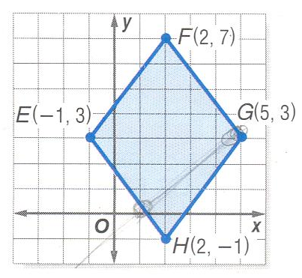
Ex 3 Area of a Rhombus on the Coordinate Plane

Slide 8
Example 4: Algebra: Find Missing Measures

