Slide 1
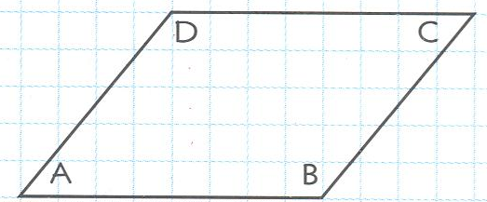
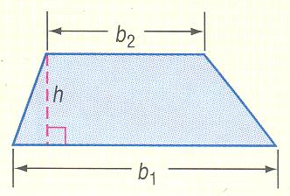

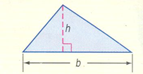



11.1 Areas of Parallelograms
Learning Targets:
We will learn to find the perimeter and area of different parallelograms
We will learn to determine whether (x, y) points form a parallelogram
Review:

Slide 2
Geometry Activity* You Have 2 Parallelograms (Only Cut One and put the Other Aside)
To find the area formula of a parallelogram, cut one of your parallelograms and then arrange the two pieces to form a rectangle (think before you cut☺)
Label your length and width on your rectangle
Go back to your original parallelogram and label segments that are equal to the length and width of the rectangle.

Slide 3
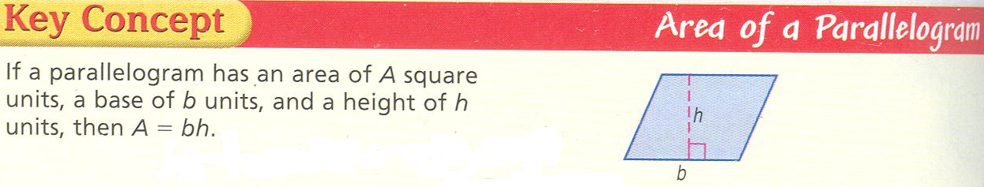

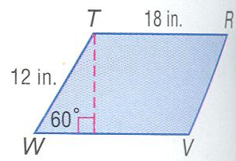
Ex 1: Perimeter and Area of a Parallelogram
We can have different parallelograms having the same area*

Slide 4
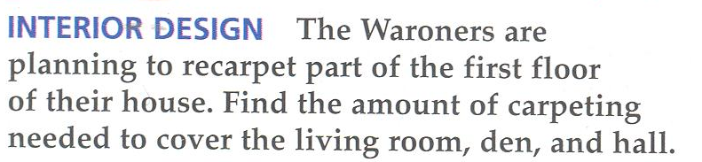
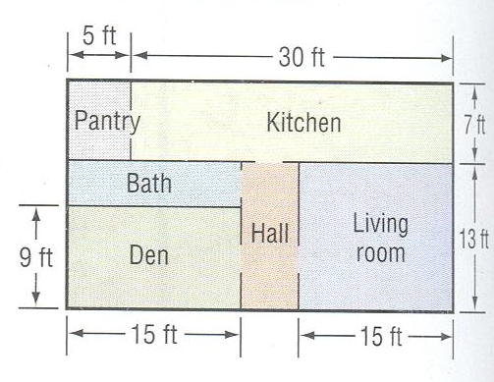
Example 2: Real World Application

Slide 5
Example 3*: Area of the x-y Coordinate Plane
With a partner write down a plan as to how to find the area of this quadrilateral!

