Slide 1
1.7 Function Notation
Objectives
Write functions using function notation.
Evaluate and graph functions.
Vocabulary
function notation
dependent variable
independent variable

Slide 2
When x = 4 evaluate y = 5x + 3
Output value
Input value
Output value
Input value
ƒ(x) = 5x + 3
ƒ(1) = 5(1) + 3
ƒ of x equals 5 times x plus 3.
ƒ of 1 equals 5 times 1 plus 3.
y = 5x + 3 (x, y) (x, 5x + 3)
Notice that y = ƒ(x) for each x.
ƒ(x) = 5x + 3 (x, ƒ(x)) (x, 5x + 3)
The graph of a function is a picture of the function’s ordered pairs.
Caution
f(x) is not “f times x” or “f multiplied by x.” f(x) means “the value of f at x.” So f(1) represents the value of f at x =1

Slide 3
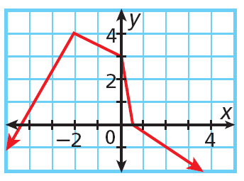
Example 1A: Evaluating Functions
For each function, evaluate ƒ(0), ƒ , and ƒ(–2).
ƒ(x) = 8 + 4x
Substitute each value for x and evaluate.
ƒ(0) = 8 + 4(0) = 8
ƒ =
ƒ(–2) =
Use the graph to find the corresponding y-value for each x-value.
ƒ(0) =
ƒ =
ƒ(–2) =

Slide 4
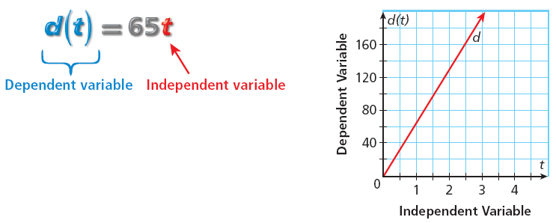
In the notation ƒ(x), ƒ is the name of the function. The output ƒ(x) of a function is called the dependent variable because it depends on the input value of the function. The input x is called the independent variable.

Slide 5
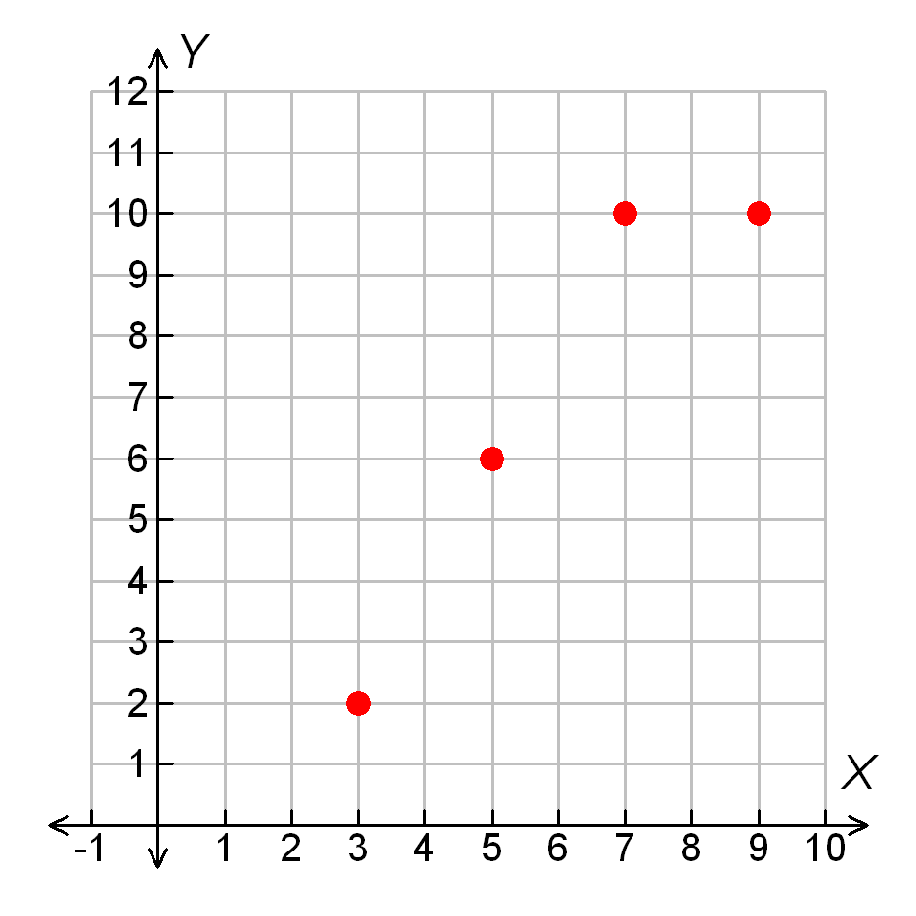
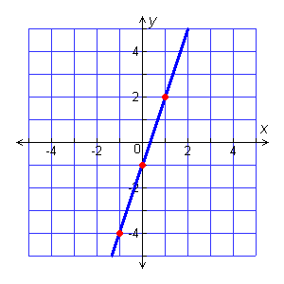
Example 2a Graphing Functions
Graph the function.
3 5 7 9
2 6 10
Do we connect the points?
Graph the function f(x) = 3x – 1.
Make a table.
f(x) = 3x – 1 | (x, f(x))
f(-1) = (3(– 1) – 1
f(0) = 3(0) – 1
f(1) = 3(1) – 1

Slide 6
Example 3A: Entertainment Application
A carnival charges a $5 entrance fee and $2 per ride.
Write a function to represent the total cost after taking a certain number of rides.
ALWAYS DEFINE: r = number of rides, C = total cost in dollars.
First, identify the independent and dependent variables.
Cost depends on the entrance fee plus the number of rides taken
Dependent variable
Independent variable
Cost = entrance fee + 2 × number of rides taken
C(r) = 5 + 2r
Replace the words with expressions.
What is the value of the function for an input of 12, and what does it represent?

Slide 7
Check It Out! Example 3a
A local photo shop will develop and print the photos from a disposable camera for $0.27 per print.
Write a function to represent the cost of photo processing.
What is the value of the function for an input of 24, and what does it represent?

