Slide 1
1.6 Relations and Functions
Objectives
Identify the domain and range of relations and functions.
Determine whether a relation is a function.
Vocabulary
relation
domain
range
function

Slide 2
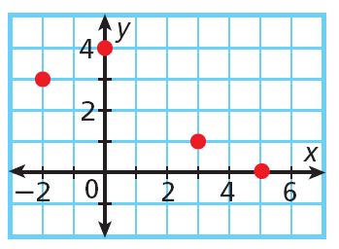
Warm Up
Use the graph for Problems 1–2.
1. List the x-coordinates of the points.
2. List the y-coordinates of the points.

Slide 3
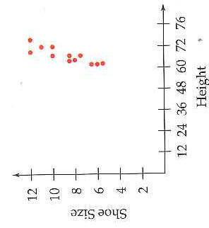
A Relation and its Domain and Range
A relation is a relationship between two variables (x,y).
Example: Height and Shoe size
What is the relationship here?
A relation can be represented by a set of ordered pairs (x,y)
A relation can also be represented by a graph →
Other ways?
Domain: Possible values that x can have.
{67, 69, 72, 76}
Range: Possible values that y can have.
{8.5, 10, 11, 12}

Slide 4
Mapping Diagram
Set of Ordered Pairs
Domain
Range
A
{(2, A), (2, B), (2, C)}
2
B
(x, y)
(input, output)
(domain, range)
C
Example 1: Identifying Domain and Range
Give the domain and range for this relation:
{(100,5), (120,5), (140,6), (160,6), (180,12)}.
Domain: { }
The set of x-coordinates.
Range: { }
The set of y-coordinates.

Slide 5
Number
{Number, Letter}
{(6, M), (6, N), (6, O)}
Enter the word MATH into a text:
{(M, 6), (A, 2), (T, 8), (H,4)}
{(2, A), (2, B), (2, C)}
This relation is a function. In a function, there is only one output for each input
{(8, T), (8, U), (8, V)}
{(4, G), (4, H), (4, I)}

Slide 6
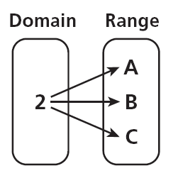
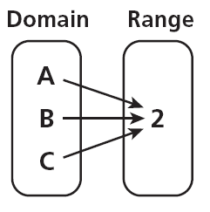
Not a function: The relationship from number to letter is not a function because the domain value 2 is mapped to the range values A, B, and C.
Ordered pairs:
Function: The relationship from letter to number is a function because each letter in the domain is mapped to only one number in the range.
Ordered pairs:

Slide 7
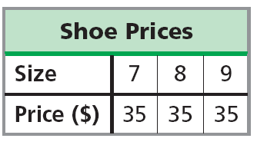
Example 2: Determining Whether a Relation is a Function
Determine whether each relation is a function.
A. from the items in a store to their prices on a certain date
B. from types of fruits to their colors
C.
D. from the number of items in a grocery cart to the total cost of the items in the cart

Slide 8
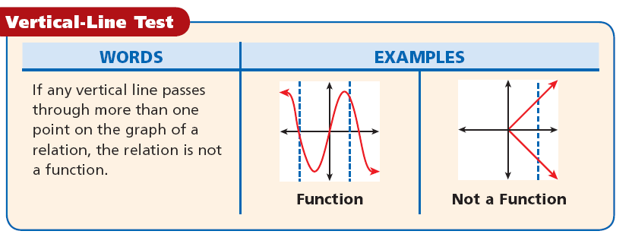
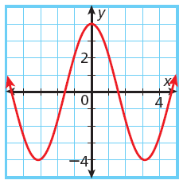
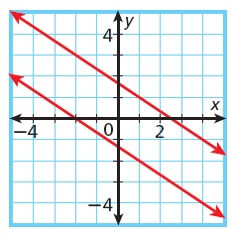
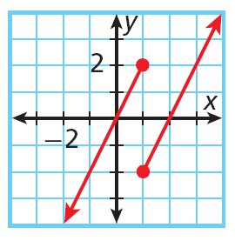
Does the graph of a vertical line represent a function?
Example 3A: Use the Vertical-Line Test to determine whether relation is function. If not, identify two points a vertical line would pass through

