Slide 1
1.5 Infinite Limits
Today, we are learning about:
Infinite Limits and Vertical Asymptotes

Slide 2
Infinite Limits
Does the limit exist?

Slide 3
Example 1: Determining Infinite Limits from a Graph
What can you say about the graphs?

Slide 4
Vertical Asymptotes
What would the continuity of f be at x = c?

Slide 5
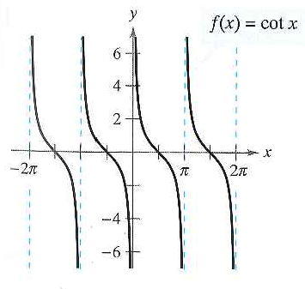
Example 2: Finding Vertical Asymptotes

Slide 6
Example 3: A Rational Function with Common Factors
Now determine the infinite limits

Slide 7
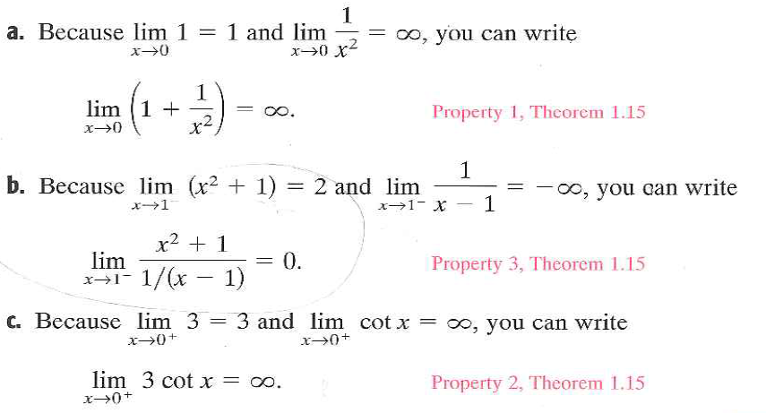
Example 4:

Slide 8
1.5 Hmwr: 3,4,5,9,17,19,23,24,29-39odd,47,55-58

