Slide 1
1.5 Properties of Exponents
Objectives
Simplify expressions involving exponents.
Use scientific notation.
Vocabulary
scientific notation

Slide 2
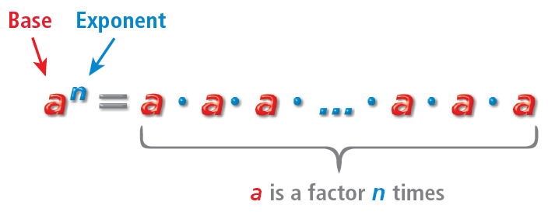
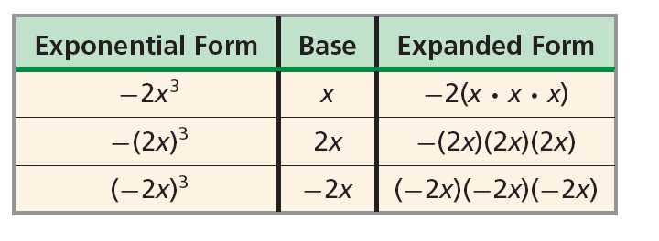
Example 1A: Writing Exponential Expressions in Expanded Form
(5z)²
Write the expression in expanded form.
(5z)²
The base is 5z, and the exponent is 2.
(5z)(5z)
5z is a factor 2 times.
Write the expressions in expanded form.:
–s⁴
3h³(k + 3)²

Slide 3
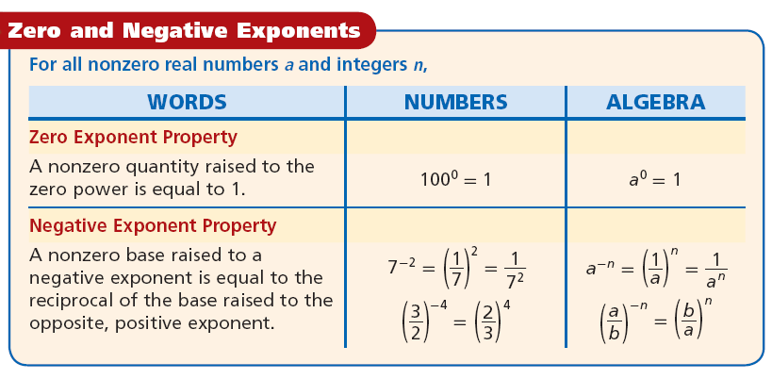
Caution!
Do not confuse a negative exponent with a negative expression.

Slide 4
Example 2A: Simplifying Expressions with Negative Exponents
3^{–2}
Simplify the expression.
The reciprocal of .
Simplify the expression.

Slide 6
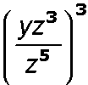
Example 3A: Using Properties of Exponents to Simplify Expressions
Simplify the expression. Assume all variables are nonzero.
3z⁷(–4z²)
3 • (–4) • z⁷ • z²
–12z⁷ ⁺ ²
Product of Powers
–12z⁹
Simplify.
Simplify the expression. Assume all variables are nonzero.

Slide 7
Use the properties of exponents to calculate numbers in scientific notation.
Example 4A: Simplifying Expressions Involving Scientific Notation
Simplify the expression. Write the answer in scientific notation.
(2.6 × 10⁴)(8.5 × 10⁷)
Divide 4.5 by 1.5 and subtract exponents: –5 – 6 = –11.
3.0 × 10^{–11}
Because 22.1 > 10, move the decimal point left 1 place and add 1 to the exponent.

Slide 8
Example 5: Problem-Solving Application
Light travels through space at a speed of about 3 × 10⁵ kilometers per second. Pluto is approximately 5.9 × 10¹² m from the Sun. How many minutes, on average, does it take light to travel from the Sun to Pluto?
1
Understand the Problem
The answer will be the time it takes for light to travel from the Sun to Pluto.
Important information:
speed of light 3 × 10⁵ km per second.
distance from the Sun to Pluto is 5.9 × 10¹² m
2
Make a Plan
Use the relationship: rate, or speed, equals distance divided by time.

Slide 9
Example 5 Continued
3
Solve
First, convert the speed of light from
There are 1000, or 10³ meters in every kilometers and 60 seconds in every minute

Slide 10
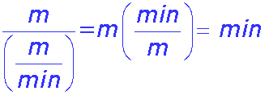
Example 5 Continued
3
Solve
Use the relationship between time, distance, and speed to find the number of minutes it takes light to travel from the Sun to Pluto.
It takes light approximately 328 minutes to travel from the Sun to Pluto.
4
Look Back
Light travels at 3 × 10⁵ km/s for 328(60) ≈ 19,666 seconds travels a distance of 5,899,560,000 = 5.89 × 10⁹ km or 5.89 × 10¹² m. The answer is reasonable.

