Slide 1
1.1- Relations and Functions

Slide 2
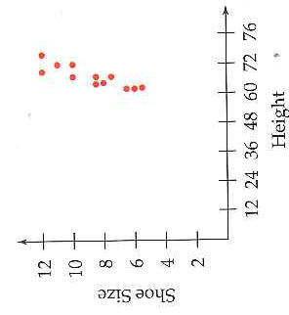
A Relation and its Domain and Range
A relation is a relationship between two variables (x,y).
Example: Height and Shoe size
What is the relationship here?
A relation can be represented by a set of ordered pairs (x,y)
A relation can also be represented by a graph →
Other ways?
Domain: Possible values that x can have.
{67, 69, 72, 76}
Range: Possible values that y can have.
{8.5, 10, 11, 12}

Slide 3
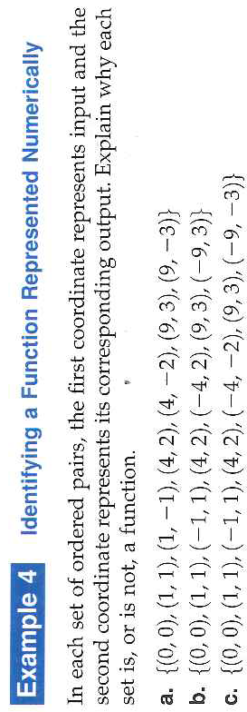
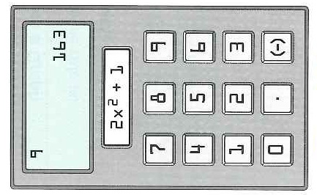
Functions
A function is a special relation →
A function can be represented by a set of ordered pairs (x,y) in which the first coordinate, x, is the input and the second coordinate, y, is the output produced from the rule of the function.
Special: Each input has one and only one output

Slide 4
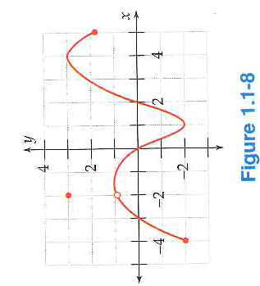
Example 5: Finding Function Values from a Graph

Slide 5
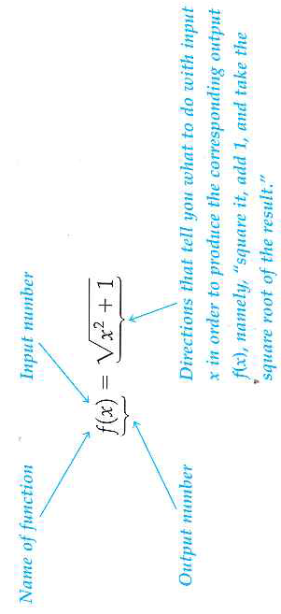
Function Notation

Slide 6
Example 6: Function Notation

Slide 7
1.1 Hmwr
p.11: 15-33 odd

